Slide 1

SCANS
NAME : VARADHA . N
UID : 161101
MAIL ID : varadha.nair@ust.com
DATE : 10/12/2020

Slide 2
SCANS
Each stage passes its results (i.e. documents or index keys) to the parent node. The leaf nodes access the collection or the indices. The internal nodes manipulate the documents or the index keys that result from the child nodes. The root node is the final stage from which MongoDB derives the result set.
COLLSCAN
Scans the each document in the collection for processing query.
IXSCAN
Process the queries based on the indexes and scans the indexes for results.

Slide 3
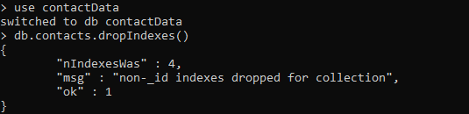
> use contactData
switched to db contactData
> db.contacts.dropIndexes()
{
"nIndexesWas" : 4,
"msg" : "non-_id indexes dropped for collection",
"ok" : 1
}

Slide 4
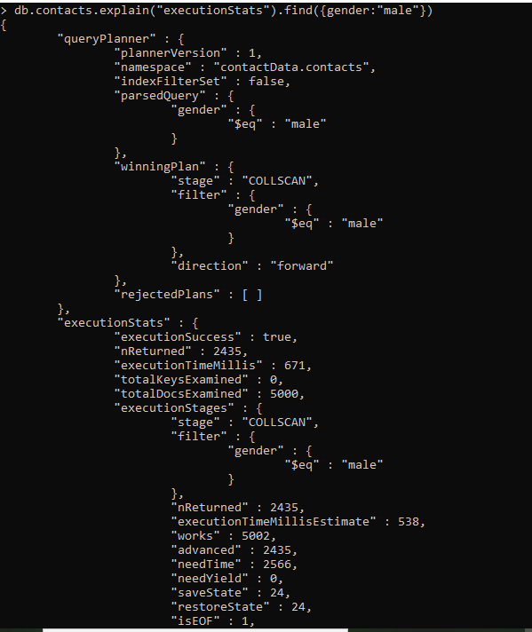

Slide 5
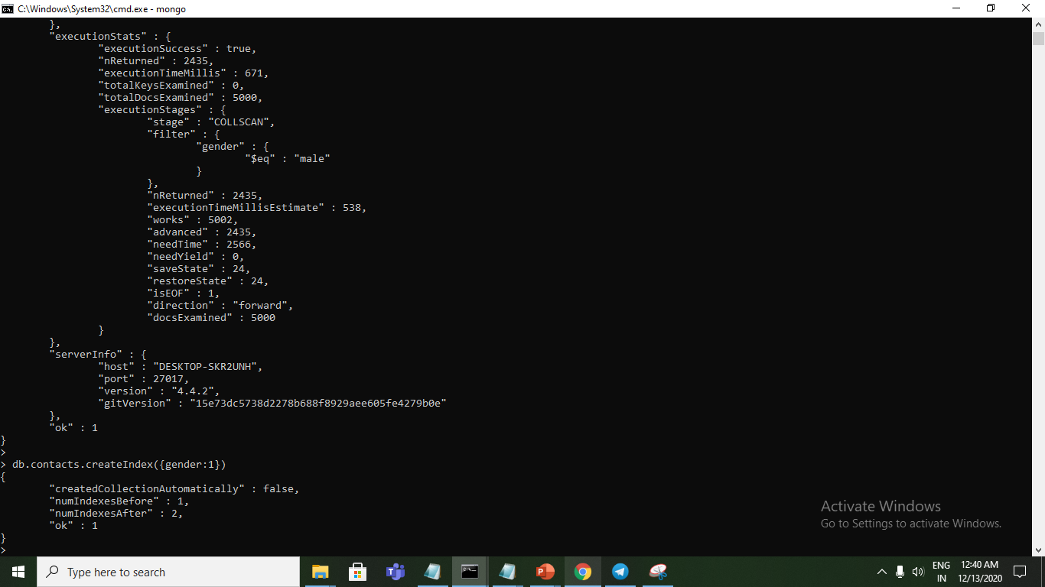
> db.contacts.createIndex({gender:1})
{
"createdCollectionAutomatically" : false,
"numIndexesBefore" : 1,
"numIndexesAfter" : 2,
"ok" : 1
}
>

Slide 6
